Slide 1
Introduction to Neural Network using PyTorch
Presentors:
ISAIC Tech Team
DATE:

Slide 2

Today’s Discussion
Who we are and more about ISAIC?
What is Artificial Neural Network?
Introduction to PyTorch
Tutorial

Slide 3
ISAIC is powering the A.I.mbition in Western Canada
Small to medium size start ups
Accelerate AI adoption and commercialization
By abstracting away hardware management

Slide 4
We offer High-performance Computing Virtual Machines
At ISAIC, we offer different flavours of high-performance VMs that come preconfigured and specifically tailored to their needs
Our services come with 1 to 8 GPUs and up to 64 CPU cores with 512GB RAM
Our offerings come ready with AI tools including newest libraries from TensorFlow, Torch, & Keras
We offer in-person expert consultation to our clients and help them through their AI journey

Slide 5
Today, we will see how ISAIC creates and uses VMs for our clients
What is a Virtual Machine?
Through virtualization we can divide existing hardware resources into multiple machines and create virtual hardware that our Operating Systems run on …..
Let’s set aside the technical terminology and definition and take a look at virtualization from an operational point of view

Slide 6
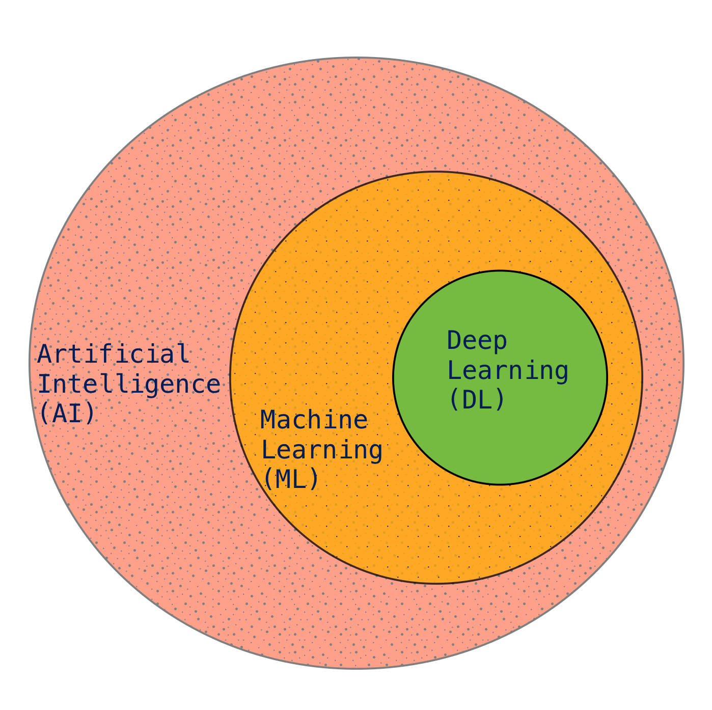
What is Artificial Neural Network?
Artificial Neural Network (NN) is a part of Deep Learning algorithms
Inspired by working principle of biological neurons in animal brains
Data driven statistical inference
Requires large volume data
Transforms input data to very high dimensional abstract space through complex model architecture

Slide 7
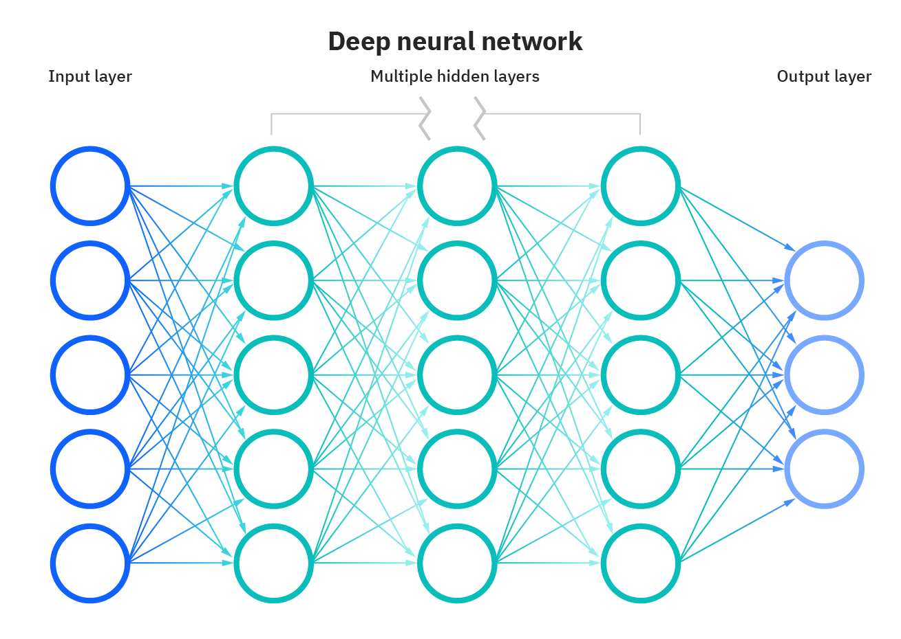
‘Vanilla’ Neural Network
Simplest form of ANN structure
Consists of input, hidden and output layer
Philosophy of “Neurons that fire together, wire together”
Relies on Stochastic Gradient Descent
Advancement of auto differentiation and computing power enables us to build such models
Image Credit: https://1.cms.s81c.com/sites/default/files/2021-01-06/ICLH_Diagram_Batch_01_03-DeepNeuralNetwork-WHITEBG.png

Slide 8



Introduction to PyTorch
Open source ML framework
Developed by Facebook and built upon Torch library
torch.tensor stores and processes multi-dimensional data in very efficient way
torch.autograd provides auto differentiation engine to perform stochastic gradient descent
APIs are intuitive, easy-to-use for ML project development

Slide 9
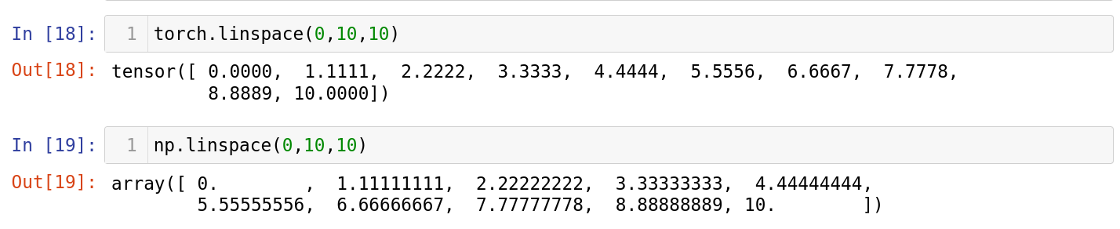
Introduction to torch.tensor
Advantages over NumPy Arrays
torch.tensor handles data very similarly as NumPy arrays, and can be converted to back and forth
Unlike NumPy arrays, torch Tensors can be computed on other devices such as GPUs, TPUs
Torch Tensors hold additional placeholder for gradients calculation
PyTorch neural network modules are designed to work efficiently on torch Tensors

